Slide 1

Notes:
Intro - Shane (1 minute)
Intro - Nicole (30 seconds)
Meet of the presentation - Nicole (10-12 minutes)
Mission/Demo - Shane (10 minutes)
How I implemented Qube and best practices when you have a tool (challenges they’ll face with clients) - Nicole (5 minutes)
Reiterate our mission, give them my email, make the offering - Shane (2 minutes)

Slide 2
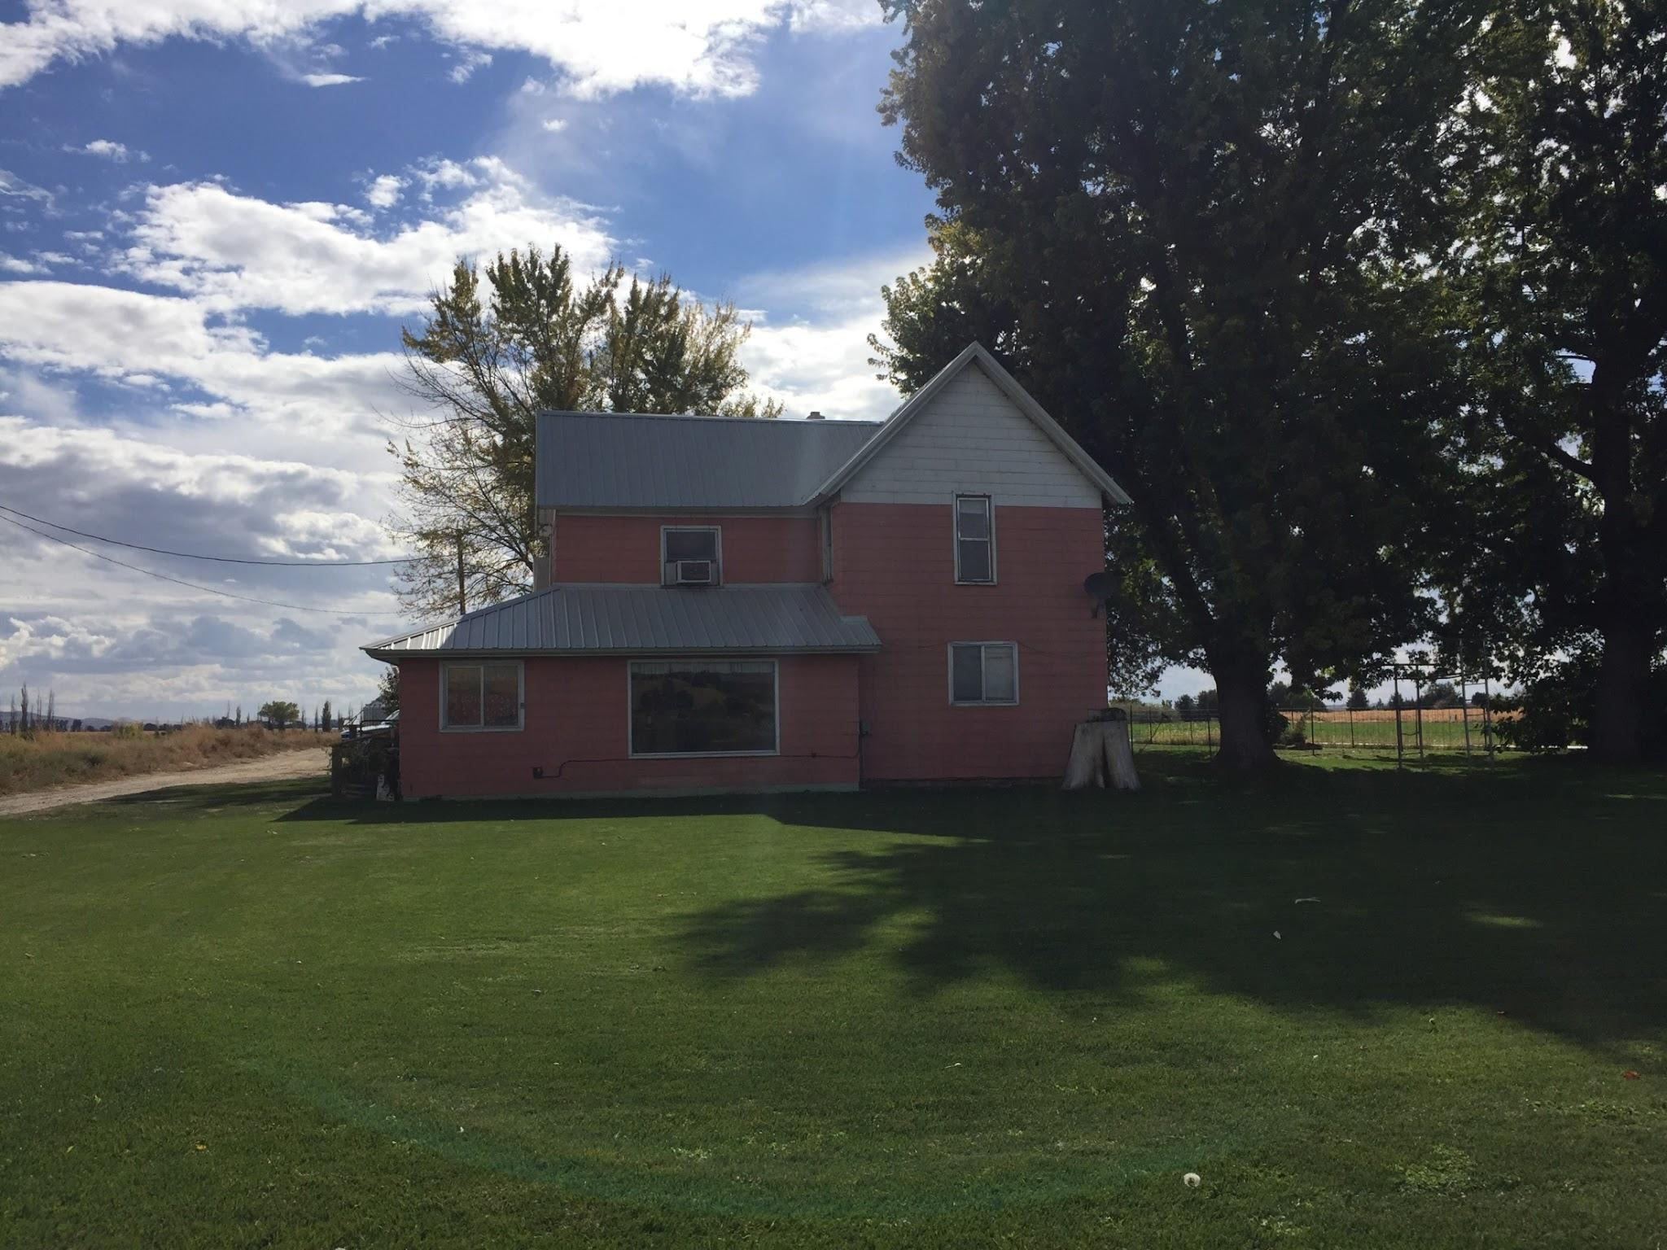

Slide 3


THE DEEPER PROBLEM
Money is the leading Cause of Stress
SOCIAL IMPACT
1 in 3 divorces (Finance Online)
1 in 3 job turnover (Morgan Stanley)
1 in 5 suicides (Aspen Institute)
Current budgeting and banking apps attempt to budget after money is already spent.

Slide 4
THE PROBLEM
Most people don’t have money to invest because they overspend.

Slide 5
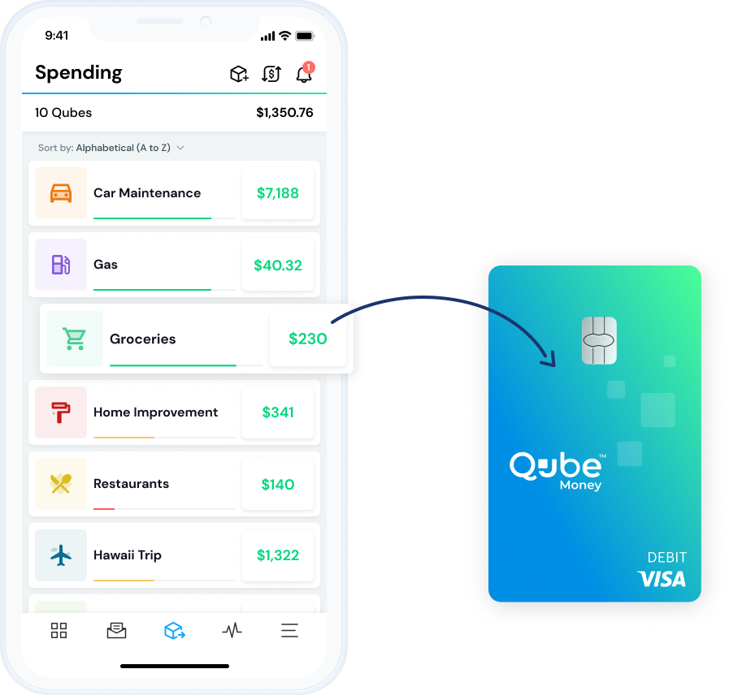
MINDFUL SPENDING
Qube Money
The world’s first banking system that gives you the control of carrying cash envelopes and the convenience of using digital money.

Slide 6
Demo

Slide 7
Use Case

Slide 8
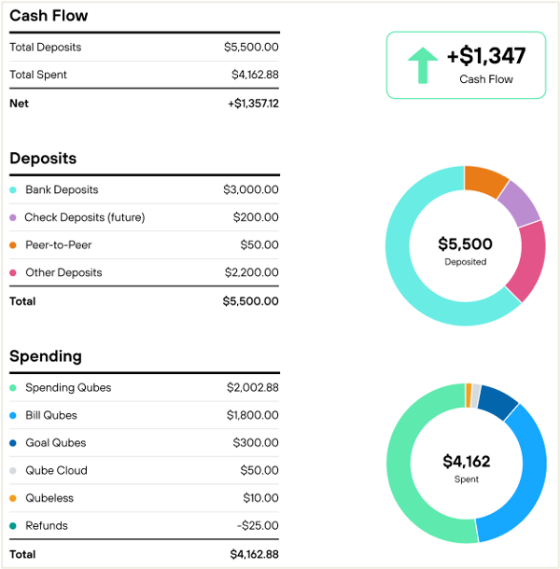
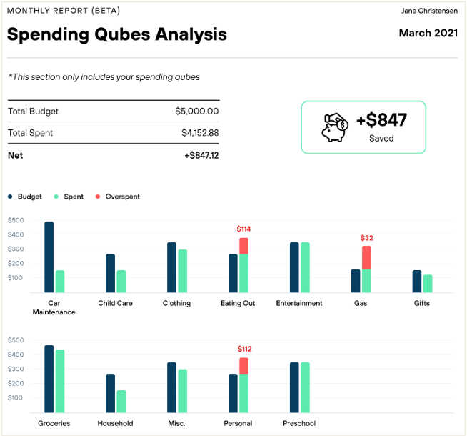
FINANCIAL HEALTH SCORE

Slide 9
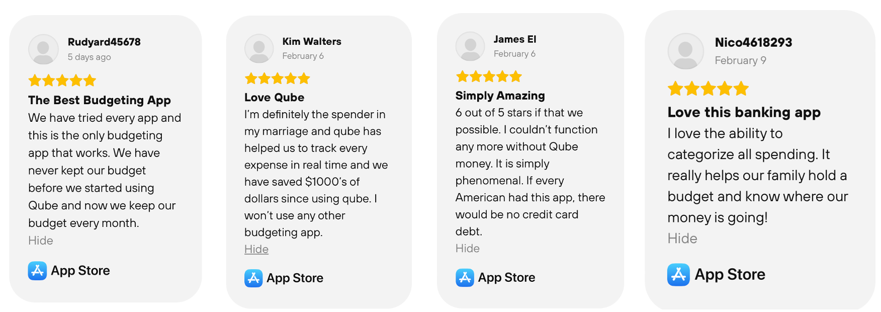
CUSTOMER ❤️ QUBE

Slide 10

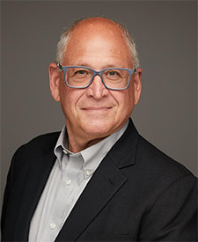
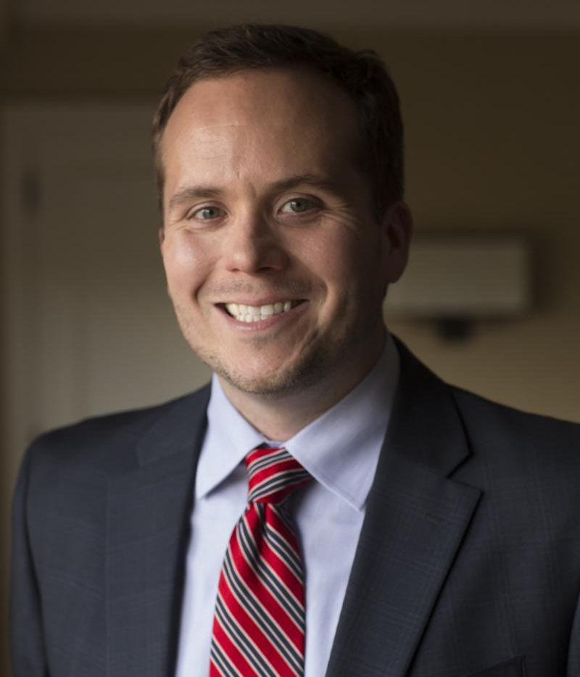
RECOMMENDATIONS
Financial Planning
Mary Bell Carlson
Joel Bruckenstein
Ph.D., CFP®, AFC®, FinTech Expert, Professor of Financial Planning at Texas Tech and the University of Georgia
President of T3 Technology, FinTech Expert
“I think Qube has real legs in the financial planning FinTech space.”
"Qube Money is unlike anything I've seen in my almost 2 decades in the financial planning, counseling, and coaching space. As a personal user, this app has the power to change not only financial behavior, but relationships and lives. It's the only budgeting app on the market that requires users to make real-time financial behavior decisions to create intentional spending."
Daniel Crosby
Ph.D. Psychology, Chief Behavior Officer of Orion Advisor Solutions, 2X NY Best Selling Author
“Qube Money is what we’ve been waiting for.”

Slide 11
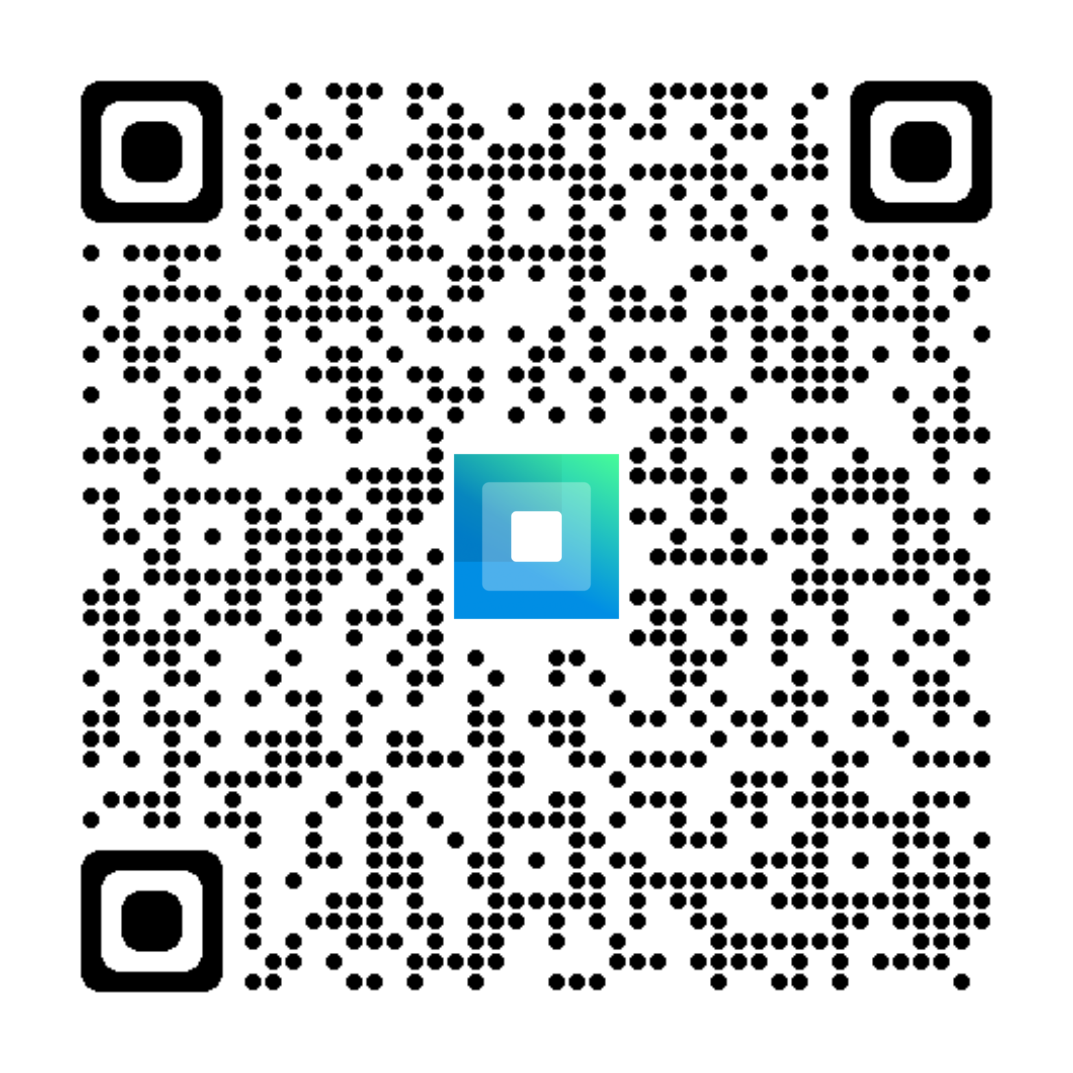
Schedule a Demo
Scan to get started

