Slide 1
FPA UT-ID Chapter
2026 – 401k & Social Security Changes

Slide 2


Slide 3
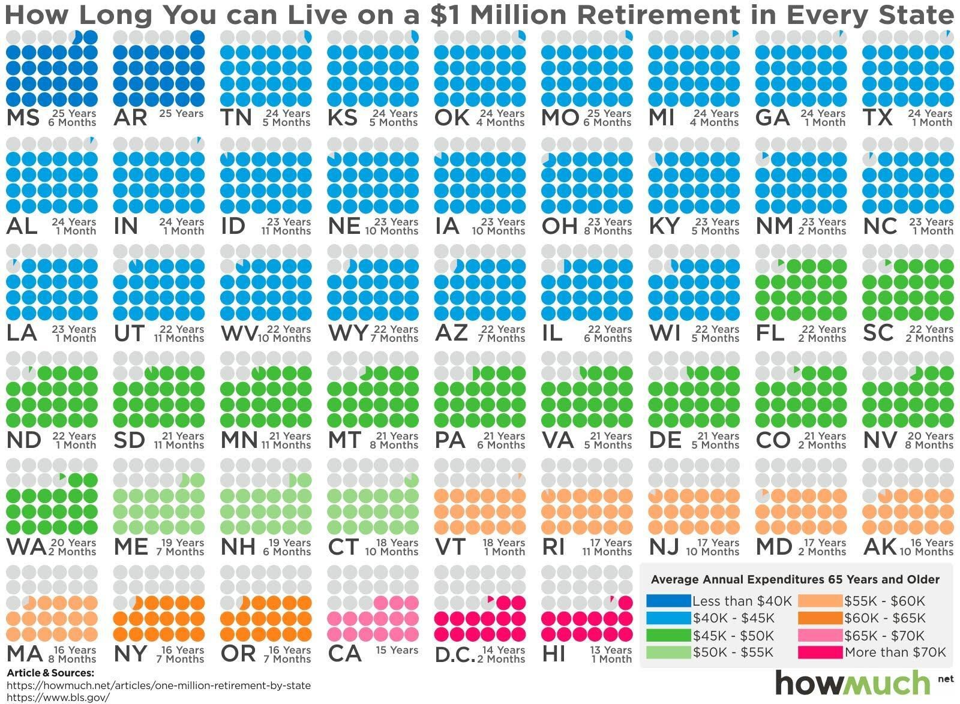
How Long - Living on $1 Million

Slide 4
401k’s
Updates for 2026

Slide 5
2026 401k Contribution Levels
2025 = $23,500
2026 = $24,500 4.255% increase
Catchup = from 2025 $7,500 to 2026 $8,000
Super catchup, age 60-63 $11,250 (no increase)

Slide 6
Trump Exec Order #14330
Allow Alt Investments in 401k’s
Secure Act #1 – allow annuities (2019)
Self Directed Brokerage Accounts (SDBA)
Executive Order, Aug 2025 - allow for enhance returns thru
  Private Equity (Reg D)
  Real Estate
  Crypto currencies – reversed Biden rule banning use in 401k’s
  Commodities
  Infrastructure
  Private Credit
  Why not just raise deferral cap by 25-50%?

Slide 7
Trump Exec Order #14330 Risk
What in common do these investments have?
Significant Risk – investor, plan sponsors, fiduciary
Unrecoverable losses
Fraud – very common in Reg D
However -- Alt’s already in DB’s & pensions

Slide 8
Trump Exec Order #14330
Regulatory Oversight
DOL rule submitted to OMB for review
  Wealth Mgmt, week of 1/12/26
  In place by spring, likely
Expect Accredited Investor Rule
  FINRA – can’t use house
  State & SEC – silent on house, sadly

Slide 9
Trump Exec Order #14330
Why the fervor?
Investment Company Institute: Q3, 2025 analysis
  401k’s: $13.9 Trillion in assets
  IRA’s: $18.9 Trillion in assets

Slide 10
Avg & Median 401k Balances
(CNBC/Vanguard, late 2025)
Ages 25-34: Average $42,640 | Median $16,255
Ages 35-44: Average $103,552 | Median $39,958
Ages 45-54: Average $188,643 | Median $67,796
Ages 55-64: Average $271,320 | Median $95,642

Slide 11
401k Balances over $1M
Fidelity: 2.4% (595k, 2025)
Empower: 9.1% (inc IRA’s, # ?, 2025)
Fed Reserve: 4.6% (inc IRA’s, 2022 data in 2025)

Slide 12
401k’s – Cryptocurrency
$17 Trillion lost last year in fraud, etc
Started to used for Money laundering, human trafficking for slavery & sex trafficking
  OFAC report – 2015
Latest: Tinder Crypto fraud, DOJ trying to recover $200k in pig butchering operation fraud
My B/D: increased E&O deduct to $100k

Slide 13
Secure 2.0 2024
401k match for student loan
Employers can match your student loan pymts by contributing to 401k for you.
Also applies to 403(b), 457 & SIMPLE IRA.
Contributions must have same match %, eligibility, vesting rules, contribution limits.
Must stay with employer for 3-5 years.
Best part: lack of IRS guidance at present

Slide 14
Coming Attractions
In-service withdrawals – all 401k’s, just intro’d 2026
Allow 401k withdrawals w/o penalty -- home purchase
  Build Equity, Swap equity into 401k to build retirement
  Not said - Left with HELC pymts where you can’t deduct interest due to Trump 2017 Jobs Act
  Versus - present
  401k 15 yr loan w/lower interest
  IRA allows $10k withdrawal
  201k home loan purchase

Slide 15
Social Security
Updates for 2026

Slide 16
Social Security Changes 2026
Social Security Benefit increase 2.8%
  Medicare Part B increases will eat up 1/3 of Soc Sec increase
Full retirement age now 67 (1960 or later)
FRA in 2026: earn to $65,160 before birth month or $1 tax for every $3
Under FRA: earn $24,480 or $1 for every $2

Slide 17
Social Security Changes 2026 (cont.)
FICA wage increase from $176,100 to $184,500
Social Security Benefit Analyzer gone
Solvency reduced from 2037 to 2033

Slide 18
Issues affecting solvency
Reduced from 2037 to 2033
Obamacare - $1 Trillion
COVID
Birth rate - 90’s: 1 vs 12-15 payors, now 1 to 1
Biden
  EV credits
  Illegals – $3,900 for 4 yrs for 5 Million people not eligible
Investments vs assumed growth of 8%

Slide 19
Coming Attractions
Congress – bill to increase death benefit
  Current $255 – proposed $2,500
  Social Security Emer Inflation relief - $200 added to all, doesn’t include new funding
  Surviving Widow(er) Income Fair Treatment – increase benefits, doesn’t include new funding

Slide 20
THANK YOU!!

