Slide 1
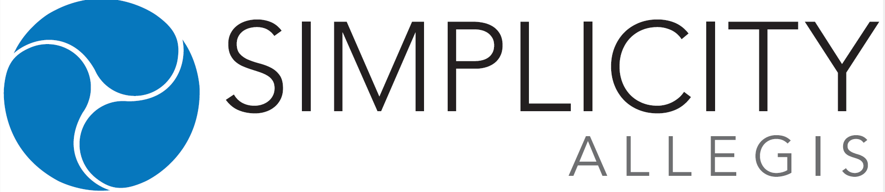
The Good, the Bad and the Ugly of Index Universal Life (IUL)
ERIC STUART
VP Life Distribution
Simplicity Allegis
801-826-3929
Eric.Stuart@simplicitygroup.com
Notes:
Twp types of IUL’s: Protection and Accumulation – we will focus on Accumulation.

Slide 2

Why Index UL is Polarizing
Loved by some agents
Hated by many
Often misunderstood by both
Bad implementations have overshadowed legitimate use cases
Notes:
Most planners’ negative experiences are justified. The product itself isn’t the core problem — how it’s sold and illustrated is.

Slide 3

Index UL a 30,000-Foot View
Permanent life insurance with:
  Death benefit
  Cash value component
Cash value linked to an index (e.g., S&P 500)
No direct market participation
Upside capped, downside floored (usually 0%)
Notes:
This is not market investing. It’s an insurance chassis using options to credit interest.

Slide 4

What Index UL is Not
❌ Not a replacement for equities
❌ Not a primary accumulation vehicle
❌ Not a “tax-free retirement plan”
❌ Not a “be your own banker”
❌ Not suitable for most people
Notes:
If someone is selling it as a Roth IRA alternative or market replacement — that’s already a red flag.

Slide 5

The Ugly
When Index UL Goes Wrong

Slide 6
The Ugly: When Index UL Goes Wrong
Aggressive illustrations
Unrealistic return assumptions
Poor funding design
High internal costs
Misaligned incentives
Notes:
The ugliest outcomes are almost always self-inflicted by bad sales practices.

Slide 7

The Kyle Busch / Pacific Life Lawsuit
High-profile athlete
Large premium IUL
Allegations include:
  Misrepresentation of policy performance
  Over-reliance on illustrated returns
  Policy underperformance vs expectations
  Commission Grab
  Planned Premium not paid
Litigation highlights systemic issues in IUL sales
Notes:
Regardless of the final legal outcome, this case highlights nearly every mistake that can be made selling IUL — especially selling the illustration instead of the product reality.

Slide 8

Why Illustrations are Dangerous
Based on:
  Non-guaranteed caps
  Non-guaranteed participation rates
  Assumed option budgets
Carriers can:
  Adjust caps
  Change spreads
  Modify crediting methodologies
Notes:
Illustrations are marketing tools, not forecasts. Two identical policies can produce very different outcomes over time.

Slide 9

Illustration Games in the Industry
Back-tested index performance
Hypothetical lookbacks
Non-repeatable crediting assumptions
Competitive “illustration arbitrage” between carriers
Notes:
Some carriers are better actors than others, but the system itself encourages gamesmanship.

Slide 10

The Bad
When Index UL is misunderstood

Slide 11
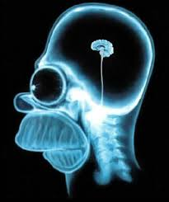
Uneducated or Undertrained Advisors
Don’t understand:
  Option mechanics
  Cost of insurance dynamics
  Sequence risk inside the policy
Don’t explain:
  Caps changing
  Policy performance drifts over time
Notes:
If the advisor can’t explain how the option budget works, they shouldn’t be selling IUL.

Slide 12

Costs and Fees Matter (A Lot)
Cost of Insurance (COI)
Policy expenses
Rider charges
Asset drag over time
Notes:
I agree with critics here: fees and costs matter. Poorly priced policies will absolutely weigh down cash value growth.

Slide 13

Why Policies Fail
Underfunded
Over-illustrated
Sold too late in life
Rising COIs in later years
No ongoing management
Notes:
Most policy failures are design failures, not market failures.

Slide 14

The Good
Where Index UL Succeed

Slide 15

The Good: A Narrow, but Real Use Case
NOT for 90%+ of people
NOT for early accumulation
MAY work for:
  High-income
  High-net-worth
  Already maxing qualified plans
Notes:
This is a supplemental tool — not a core holding.

Slide 16

Risk Management: The Real Value
Not return maximization
But volatility management
Non-correlated cash bucket
Behavioral and sequencing benefits

Slide 17

Sequence of Returns Risk (Why This Matters)

Slide 18
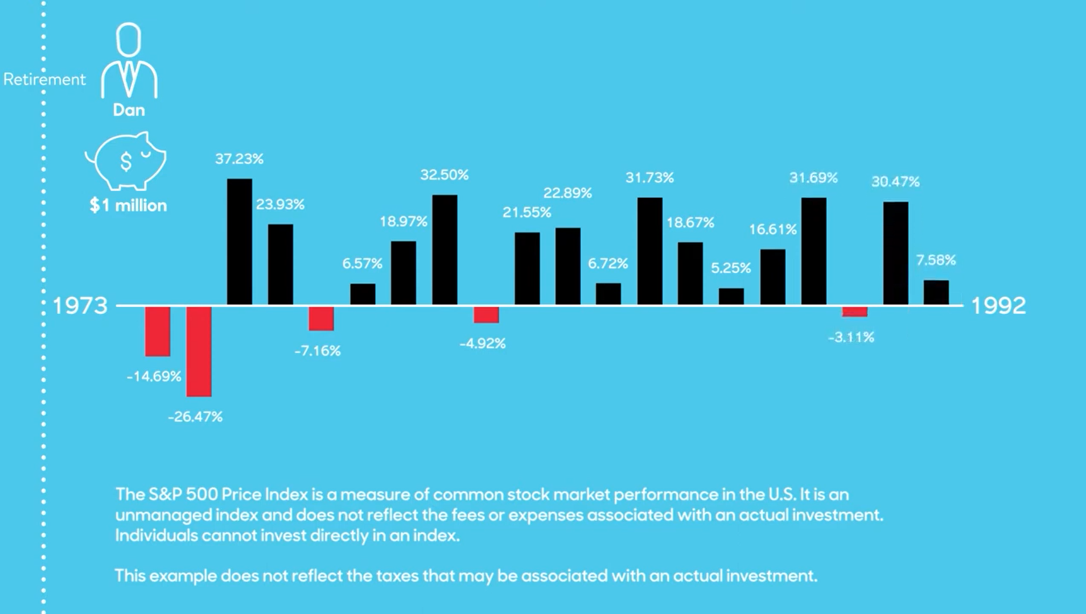
Sequence of Returns Risk (Why This Matters)
Early negative returns can permanently damage portfolios
Especially in:
  Early retirement
  Distribution phase
Selling equities after downturns locks in losses
Notes:
Sequence risk is math, not opinion.

Slide 19
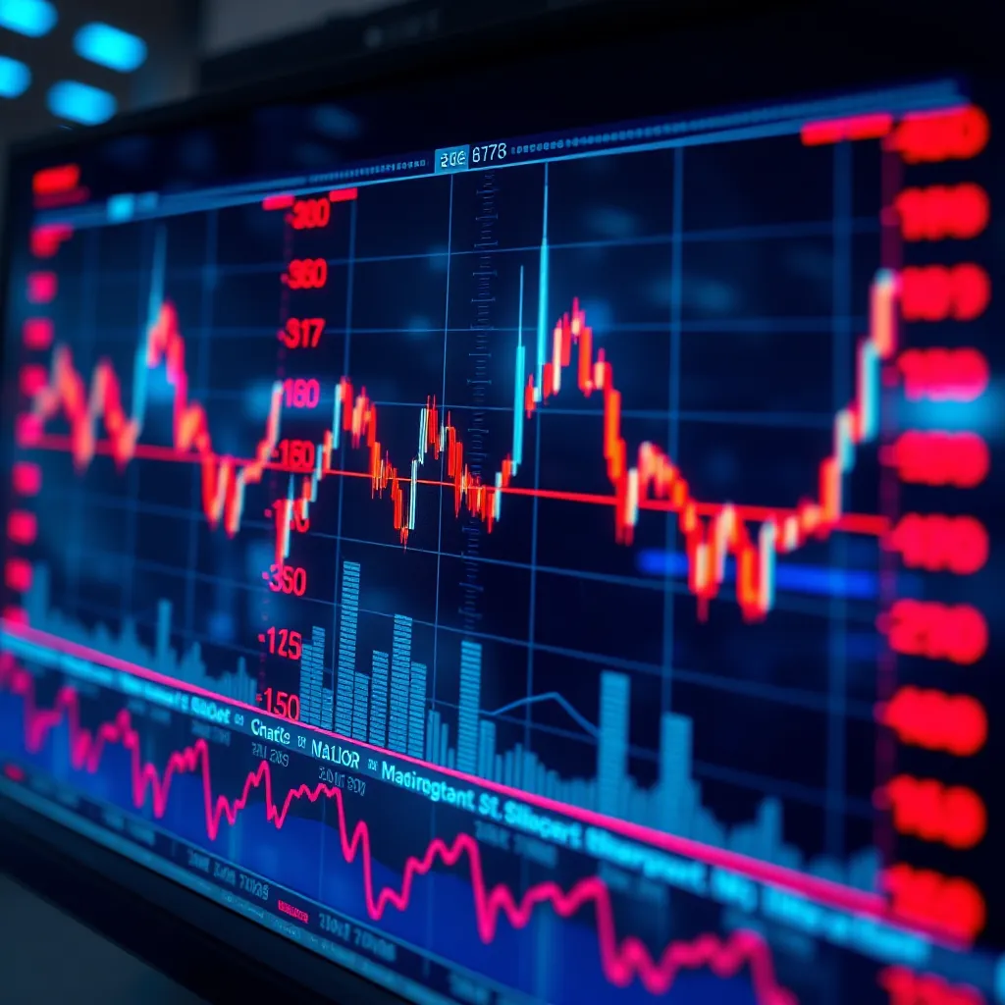
Index UL as a Volatility Buffer
Provides:
  Liquidity after down markets
  Non-market-correlated capital
Allows:
  Equities time to recover
  Smarter withdrawal sequencing
Notes:
Think “buffer asset,” not “growth engine.”

Slide 20

IUL’s Proper Role in a Portfolio
Small percentage allocation
Complements:
  Equities
  Bonds
  Cash
Used tactically, not emotionally

Slide 21

What “Good” Index UL’s Look Like
Conservatively illustrated
Lower-cost carrier
Max-funded early
Stress-tested assumptions
Ongoing policy management
Notes:
If it only works at 7–8% forever, it doesn’t work.

Slide 22

How Index UL SHOULD Be Sold
Based on:
  Fees and Costs
  Reputation of Carrier on “New Money – Old Money”
  Risk tradeoffs
NOT based on:
  Best-case illustrations
  Back-tested hype
  “Tax-free retirement” slogans
Notes:
Sell it for what it is, not what a spreadsheet says it could be.

Slide 23

Common Objections (and Fair Responses)
“Returns are too low”
→ Agreed. That’s not the goal.
“Fees are too high”
→ True for many policies. Carrier selection matters.
“It’s overly complex”
→ Also true. Complexity must earn its place.

Slide 24

Who Should Never Own an IUL
Young accumulators
Underfunded households
Clients chasing returns
Anyone who doesn’t understand the tradeoffs

Slide 25

Fiduciary Test for Index UL
Ask yourself:
Would this still make sense with no commission?
Does this solve a specific risk?
Is this replacing something better?
Notes:
If you can’t answer “yes” clearly, don’t do it.

Slide 26

Final Takeaways
IUL is:
  ❌ Not evil
  ❌ Not magical
  ✅ Often misused
When used correctly:
  Small role
  Specific purpose
  Conservative expectations
Notes:
The problem isn’t IUL.
The problem is how often it’s sold for what it is not.

Slide 27
Q & A

Slide 28
Thank you!
ERIC STUART
VP Life Distribution
801-826-3929
Eric.Stuart@simplicitygroup.com

